Slide 1
Ideation & Design Thinking
Sep 2023

Slide 2
What is Design Thinking?
Design thinking is a mindset and approach to problem-solving and innovation anchored around human-centered design. While it can be traced back centuries—and perhaps even longer—it gained traction in the modern business world after Tim Brown, CEO and president of design company IDEO, published an article about it in the Harvard Business Review.
Design thinking is different from other innovation and ideation processes in that it’s solution-based and user-centric rather than problem-based. This means it focuses on the solution to a problem instead of the problem itself.
For example, if a team is struggling with transitioning to remote work, the design thinking methodology encourages them to consider how to increase employee engagement rather than focus on the problem (decreasing productivity).

Slide 3
What is Design Thinking?
The essence of design thinking is human-centric and user-specific. It’s about the person behind the problem and solution, and requires asking questions such as “Who will be using this product?” and “How will this solution impact the user?”
The first, and arguably most important, step of design thinking is building empathy with users. By understanding the person affected by a problem, you can find a more impactful solution. On top of empathy, design thinking is centered on observing product interaction, drawing conclusions based on research, and ensuring the user remains the focus of the final implementation.

Slide 4
Design Thinking Phases
The phases of Design Thinking that influenced the modern day process were coined by Nobel Prize laureate Herbert Simon in 1969, and originally included 7 steps.
Modern versions of the process include anywhere from 5-6 steps.

Slide 5
4-phase version
In the online course ”Design Thinking and Innovation”, Harvard Business School Dean Srikant Datar leverages a four-phase innovation framework. The phases venture from concrete to abstract thinking and back again as the process loops, reverses, and repeats. This is an important balance because abstract thinking increases the likelihood that an idea will be novel. It’s essential, however, to anchor abstract ideas in concrete thinking to ensure the solution is valid and useful.
Here are the four phases for effective innovation and, by extension, design thinking.

Slide 6
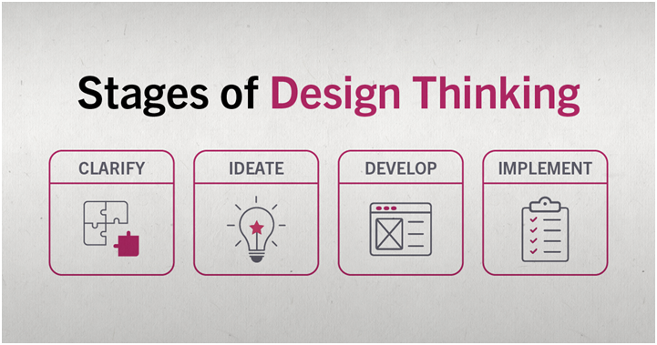
4-phase version

Slide 7
Rules of Design Thinking
Christoph Meinel and Harry Leifer of the Hasso-Plattner-Institute of Design at Stanford University (d.school) identified four rules of Design Thinking:
The human rule: design is social in nature — problems must be solved in a way that satisfies human needs and acknowledge the human elements in all technologies.
The ambiguity rule: ambiguity is inevitable — experiment at the limits of our knowledge, the limits of our ability to control events, and with the freedom to see things in a different light.
The re-design rule: all design is re-design — technology and social circumstances are constantly evolving. We need to understand how our human needs were met in the past.
The tangibility rule: making ideas tangible facilitates communication — this directly refers to creating prototypes.

Slide 8
5-phase version
The 5 step process proposed by the Hasso-Plattner Institute of Design at Stanford is as follows:
1. Empathize
The empathize stage is critical to understand where the problems you are trying to solve come from. Immerse yourself into the life of your user to understand their problems. This can also be thought of as finding “gaps in the market”, where there are no straightforward product solutions to a given issue. Identify the need and address it. This phase focuses on research.
2. Define
Now that a need is identified and research is collected, you can define the problem in human-centric terms. You want this problem to be broad enough for a flexible and creative approach, but narrow enough to hone in on the problems niche.
An example of a successful human-centric problem definition could be:
“Professionals need a way to virtually take notes, mark their calendar, set reminders, and sync them for access on work and home devices to streamline organization.”

Slide 9
5-phase version
3. Ideate
Now that you understand your users problems and have analyzed your research, you can begin generating ideas to solve the defined problem.
A popular way to generate ideas is with a brainstorm. Arrange a meeting with at least four people to start off. Try to come up with as many phrases or word associations as you can — no limits, no rules! Bring in a couple individuals from other teams. People with outside experience contribute valuable ideas by looking at the problem through an alternative lens. The ideate phase focuses on free thinking and unconventional approaches.
4. Prototype
Using the best ideas from the ideate phase, you can now produce several basic iterations of your problem solving product. Early stages of the prototype phase are generally where user testing allows designers to identify kinks or missing elements of their designs. This stage focuses on experimenting by creating multiple approaches to solving the problem.

Slide 10
5-phase version
5. Test
The final stage of the design thinking process, designers now combine the best solutions from the prototype phase into one complete product. This phase involves the most user-testing.
However, the design thinking phases are not linear and the test phase is not a strict ending point. Often, testing the final product surfaces new problems and is followed by another define phase, or redirects designers to the empathy phase to work on building a deeper understanding of the user. Even if designers do not need to back track to different phases, the test phase focuses on fine-tuning the product to create the best possible solution.

Slide 11
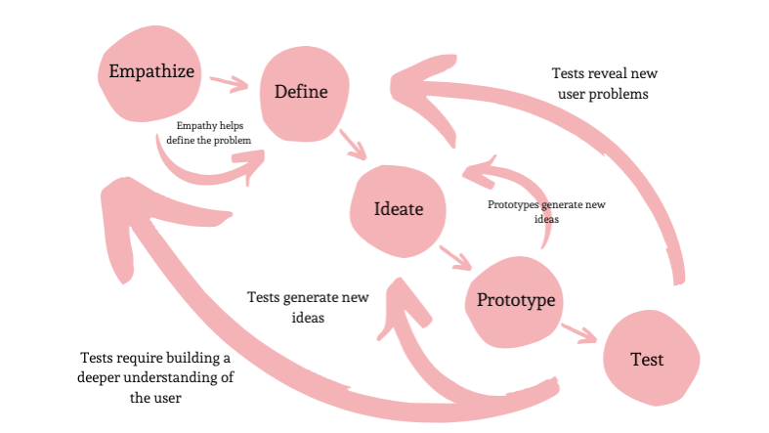
Summary

Slide 12
GOOTB
Pronounced “go͞ot-bə,” it stands for Getting Out Of The Building.
The phrase comes from the practice of intentionally going out into the world for research as opposed to just getting information from people around you at home, from friends, in the office, or at school.
It could just as easily —and perhaps more accurately— be GOOYB: Getting Out Of Your Bubble.
Product teams make strides to involve customers early on at the discovery stage and then after a period of building their solutions, validate their prototypes/products with customers. The fault in this is the huge gap between the discovery stage and launch stage where teams don’t engage customers and possibly build something completely disparate from what the market needs, hence leading to huge UX debt.

Slide 13
GOOTB
According to Steve Blank in his acclaimed book, ”The Four Steps to the Epiphany”, the ideal approach is to embrace a culture of cultivating a frequent customer feedback loop throughout the product development cycle with the mindset that a bulk of the answers are out there — not in our designer minds, sticky notes or computers and will only remain latent until we engage customers.
Customer discovery which entails observing & interviewing customers seeks to discover their behaviors, motivations, and needs, expose problems and design opportunities, and find crucial information to drive design decisions.

Slide 14
Design Thinking Tools
Beginner’s Mindset – Everyone has their own understanding, experiences and mindset. This forces us to think in certain ways. Assuming a beginner’s mindset enables us to set the biases aside and see the situation with fresh eyes.
What / How/ Why – It is a tool to delve deeper into the problem. Observe what the subjects are doing, how they are doing the tasks and the motivations and emotions behind the actions.
Extreme users – They give valuable insights into the work-arounds they may have implemented.

Slide 15
Design Thinking Tools
Journey mapping (or experience mapping) is an ethnographic research method that focuses on tracing the customer’s “journey” as he or she interacts with an organization while in the process of receiving a service, with special attention to emotional highs and lows. Experience mapping is used with the objective of identifying needs that customers are often unable to articulate.
Assumption testing focuses on identifying assumptions underlying the attractiveness of a new business idea and using available data to assess the likelihood that these assumptions will turn out to be true. These assumptions are then tested through thought experiments, followed by field experiments, which subject new concepts to four tests: value creation, execution, scalability, and defensibility.

Slide 16
Design Thinking Tools
Mind mapping is used to represent how ideas or other items are linked to a central idea and to each other. Mind maps are used to generate, visualize, structure, and classify ideas to look for patterns and insights that provide key design criteria.
Prototyping techniques allow us to make abstract new ideas tangible to potential partners and customers. These include storyboarding, user scenarios, experience journeys, and business concept illustrations — all of which encourage deep involvement by important stakeholders to provide feedback.

Slide 17
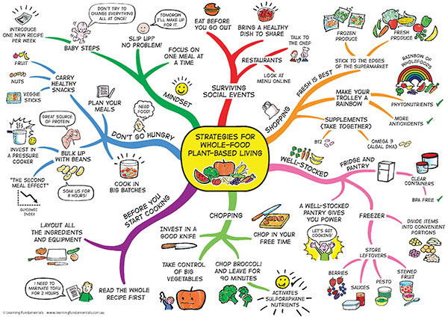
Example Mind-Map

Slide 18
Design Thinking Tools
Empathy Map - An empathy map is a widely-used visualization tool within the field of UX and HCI practice. In relation to empathetic design, the primary purpose of an empathy map is to bridge the understanding of the end user.
Both the process of making an empathy map and the finished artifact have important benefits for the organization:
Capture who a user or persona is. The empathy-mapping process helps distill and categorize your knowledge of the user into one place. It can be used to:
Categorize and make sense of qualitative research (research notes, survey answers, user-interview transcripts)
Discover gaps in your current knowledge and identify the types of research needed to address it. A sparse empathy map indicates that more research needs to be done.
Create personas by aligning and grouping empathy maps covering individual users
Communicate a user or persona to others: An empathy map is a quick, digestible way to illustrate user attitudes and behaviors. Once created, it should act as a source of truth throughout a project and protect it from bias or unfounded assumptions.

Slide 19
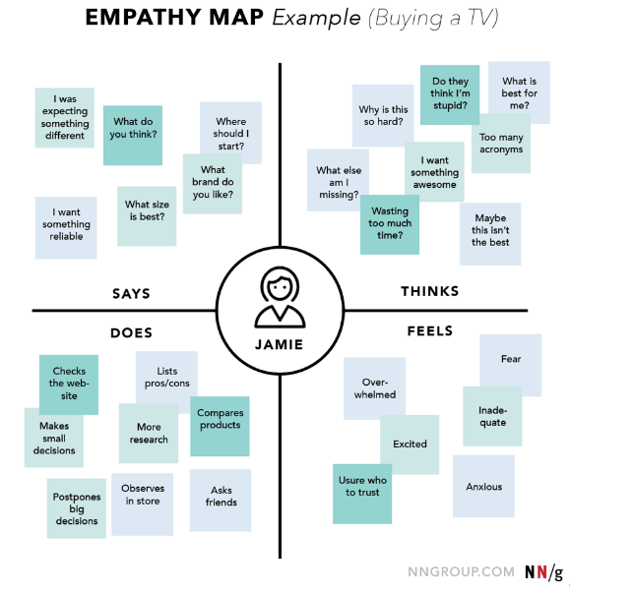
Design Thinking Tools

Slide 20
Edward DeBono - Six Thinking Hats
Six Thinking Hats was written by Dr. Edward de Bono. "Six Thinking Hats" and the associated idea parallel thinking provide a means for groups to plan thinking processes in a detailed and cohesive way, and in doing so to think together more effectively.
The premise of the method is that the human brain thinks in a number of distinct ways which can be deliberately challenged, and hence planned for use in a structured way allowing one to develop tactics for thinking about particular issues. De Bono identifies six distinct directions in which the brain can be challenged. In each of these directions the brain will identify and bring into conscious thought certain aspects of issues being considered (e.g. gut instinct, pessimistic judgement, neutral facts).

Slide 21
Edward DeBono - Six Thinking Hats
Here's what each hat is about:
Yellow hat is about positivity. Try seeing the benefits of this decision and what opportunities it opens.
Green hat represents creativity. Let your mind run free and generate ideas without censoring them. Try coming up with creative options and solutions. Tools like the Productive Thinking Model or First Principles can help you.
Red hat is about emotions. How do you feel about this? Use your intuition and gut feelings. Try to see how others might react emotionally. It's a great way to bring emotions into an otherwise rational process.
White hat makes you focus on the data. Analyze the available data and trends. This represents a very rational approach.
Black hat represents looking at the downside. What are the worst-case scenarios? Take a defensive approach, imagine any potentially negative outcomes, see what might not work. Inversion might be a helpful tool here.
Blue hat is for controlling the process. Especially in meetings, it's good to be able to step in when there's no progress and enable the group to move forward (e.g. by shifting the thinking or discussion to a different hat/perspective).

Slide 22
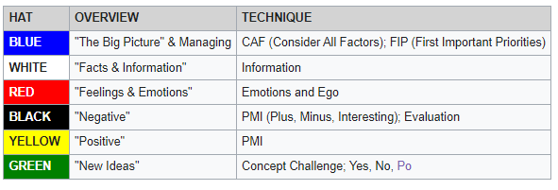
Six Thinking Hats

Slide 23
Po (lateral thinking)
The term po was created by Edward de Bono as part of a lateral thinking technique to suggest forward movement, that is, making a statement and seeing where it leads to.
It is an extraction from words such as hypothesis, suppose, possible and poetry, all of which indicate forward movement and contain the syllable "po."
Po can be taken to refer to any of the following: provoking operation, provocative operation or provocation operation.

Slide 24
Po (lateral thinking)
For example, in response to "sales are dropping off because our product is perceived as old fashioned":
po: Change the colour of the packaging
po: Flood the market with even older-looking products to make it seem more appealing
po: Call it retro
po: Sell it to old people
po: Sell it to young people as a gift for old people
po: Open a museum dedicated to it
po: Market it as a new product
Some of the above ideas may be impractical, not sensible or not business-minded. The value of these ideas is that they move thinking from a place where it is entrenched to a place where it can move.

Slide 25
Ideation
Warren Buffet says “Today’s successful companies live and die according to the quality of their ideas”
In the real world, one needs to generate a bunch of ideas and evaluate them in the underlying hope that some of them would have some business potential.
Creativity is thinking new things and innovation is in doing new things. Entrepreneurship is building a business around a new way of doing things.
One can be creative by thinking differently about existing problems and solutions.

Slide 26
Sources of Business Ideas
Past work experience
Hobbies and Interests
Strengths and Abilities
Friends and Family
Travel
Books and Magazines
Research Organizations e.g. CSIR
The web and the current trends

Slide 27
Idea Evaluation
The 3 step process helps evaluate ideas and focus on the best idea.
The steps of this process are:
Decision matrix analysis – helps analyze all the ideas and shortlist a few
Paired comparison – helps compare pairs of ideas to find the better one
5Qs exercise – final check to prioritize the ideas and arrive at the best one.

Slide 28
Decision Matrix Analysis
The decision matrix helps bring all the ideas into one place and lets you put down the factors that affect them.
The factors for business selection are:
Investment required
Ease of operations
Marketability
Fit with your strengths and interests
Product differentiation
Each factor has to be given a relative weight.
Assign a score to each idea-factor combination (scale: 0 to 5) and rank the ideas per the cumulative score.

Slide 29
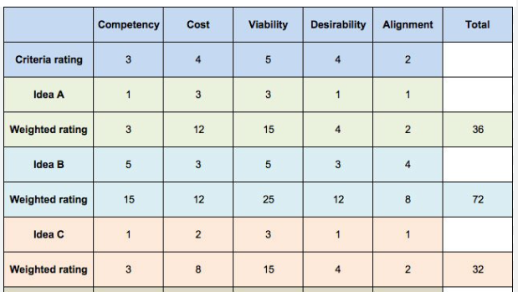
Sample DMA

Slide 30
Paired comparison analysis
This tool helps compare one idea with the other and evaluate which idea is better.
The comparison is based on the individual’s view of the potential of each idea.
The combined scores from the Decision Matrix Analysis and Paired Comparison Analysis will help decide which of the shortlisted ideas has the best potential.

Slide 31
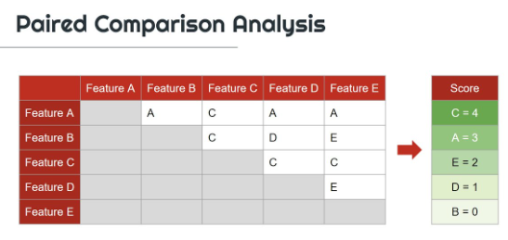
PCA Example

Slide 32
5Qs Exercise
The top few ideas can be put through this framework, which is based on 5 questions. The main questions help us group many more questions which address a wide range of concerns:
Which is the market segment being targeted?
What is the business model?
How big is the market?
How can you protect the business?
What are you getting out of it?

Slide 33
References
Entrepreneurship (3rd Ed.) – Rajeev Roy

